Slide 1

HOTEL BOOKING
PRESENTED BY: ABHISHEK KARIYA
PROJECT TYPE : EDA
GUIDED BY :ABHISHEK WAVHAL

Slide 2

SUMMARY & INTRODUCTION OF PROJECT
In this project we have a huge data set.
The data set includes the data of two hotels, hotel booking, booking cancel, stay in, checkout , booking by agents
members includes child, adults and babies and all the data is divided into 3 time duration that is year 2015, 2016 and 2017.
We have to perform the 3 main task in it.
1st is we need to clean the data.
2nd is to do some feature engineering according to the visualization demand.
3rd is create a dashboard according to requirements.

Slide 3
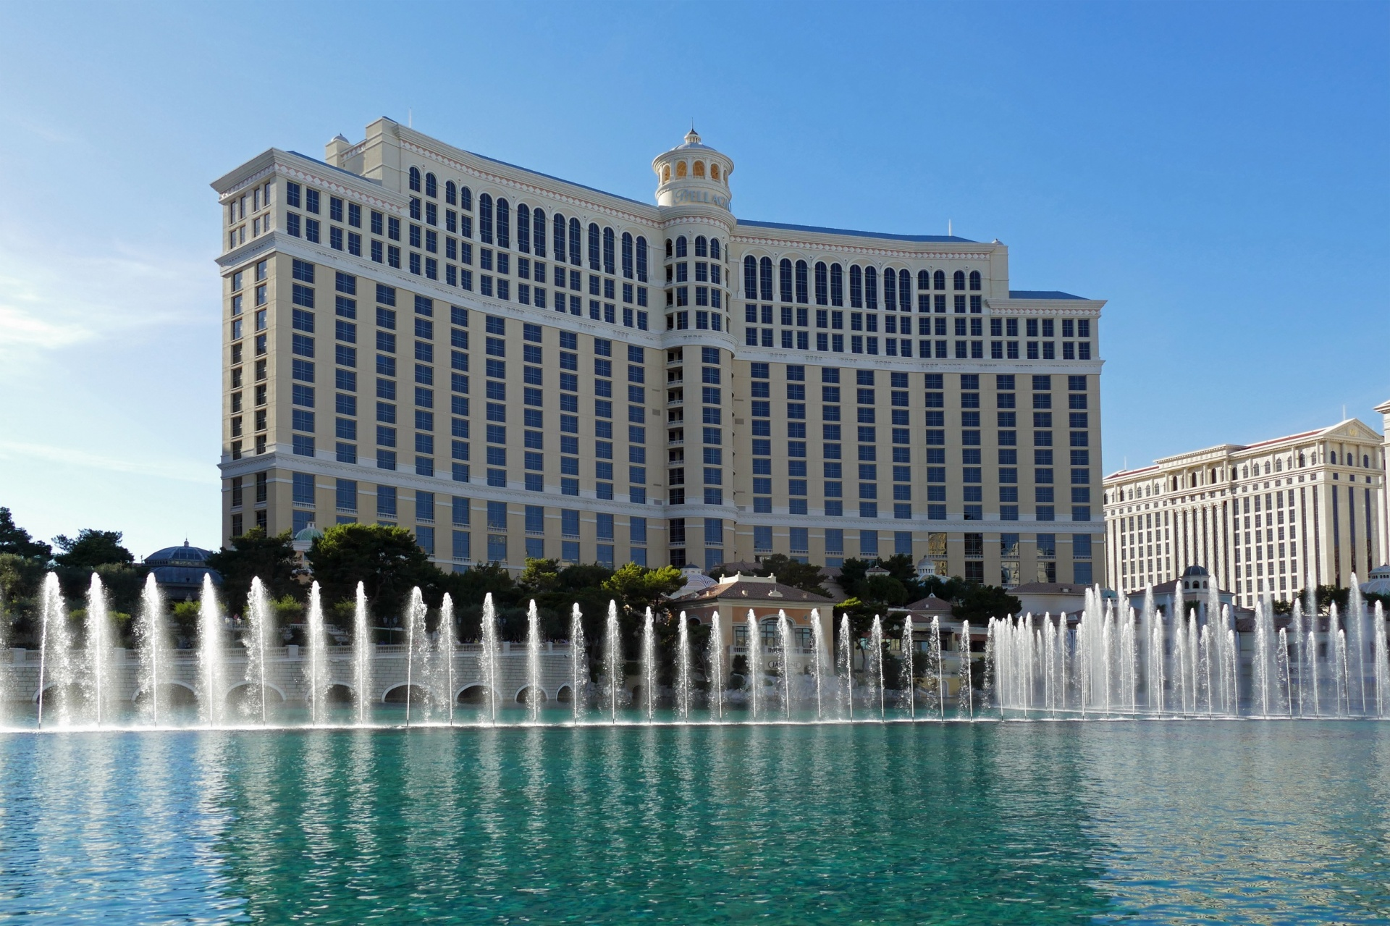
WHAT IS DATA CLEANING ?
Data cleaning is a process of removing the un necessary data.
If we not remove that data then its may generates barrier in analysis and not provide accurate result.
In the data set there are few errors and duplicates data..
So we perform some function and clean the data

Slide 4

DATA CLEANING PROCESS
STEP 1 : FIND THE ERROR
STEP 2 : REMOVE THAT ERROR USING THE POWER BI INBULT FUNCTION
STEP 1: FIND THE DUPLICATES
STEP 2 : REMOVE THE DUPLICATES

Slide 5
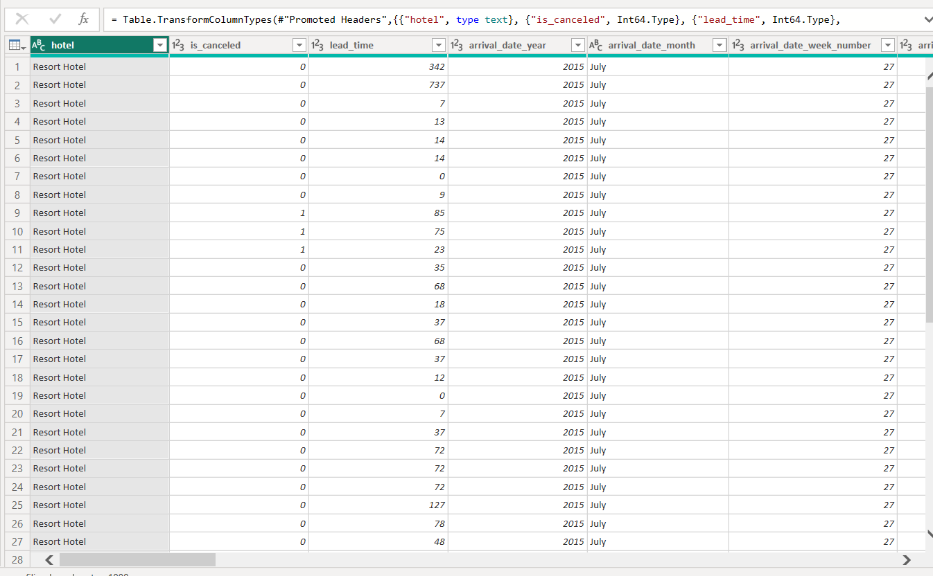
IMPLEMENTING THE DATA CLEANING PROCESS:
The above represent the view of the data
In the data there are 32 columns and 1,19,390 rows which represent the “big data”.
There is possibility of having duplicate data and errors.

Slide 6
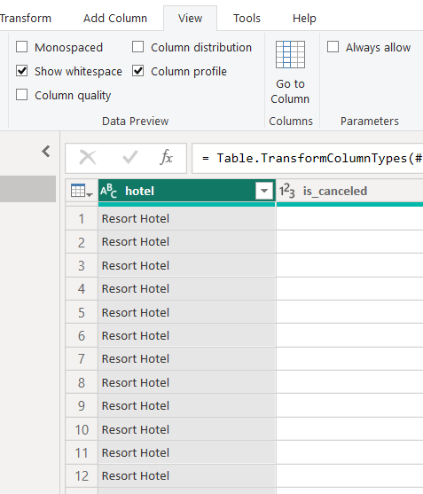
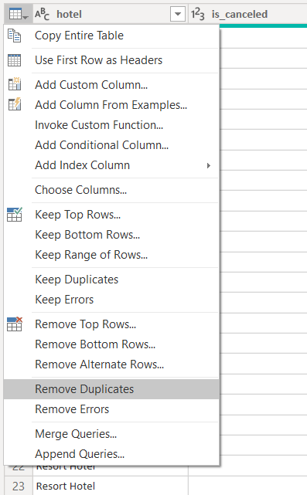
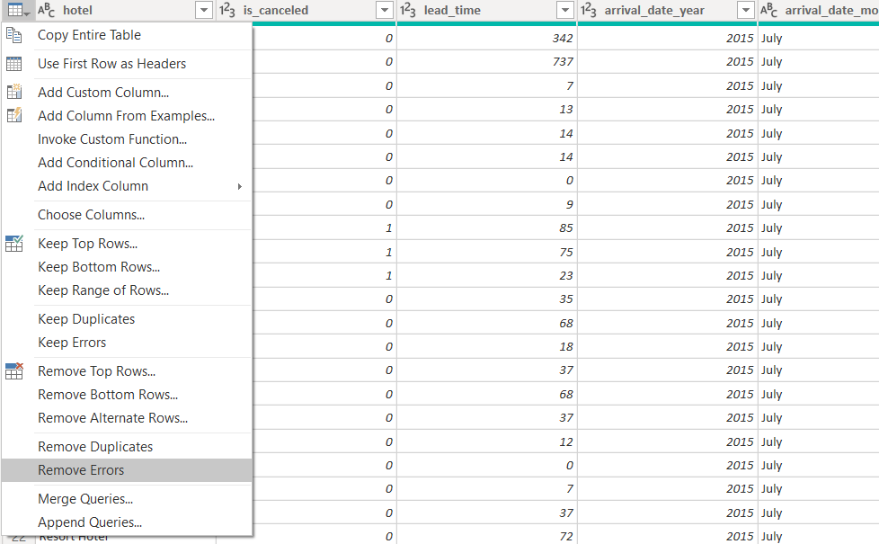
DATA CLEANING PROCESS :
STEP 3 : REMOVE DUPLICATES OF THE ENTIRE DATASET USING POWER BI REMOVE DUPLICATES INBUILT FUNCTION
STEP 1 : ENABLE COLUMN PROFILE FROM VIEW TO GET THE CALCULATE DATA
STEP 2 : REMOVE ERRORS OF ENTIRE DATA SET USING POWER BI INBUILT FUNCTION

Slide 7
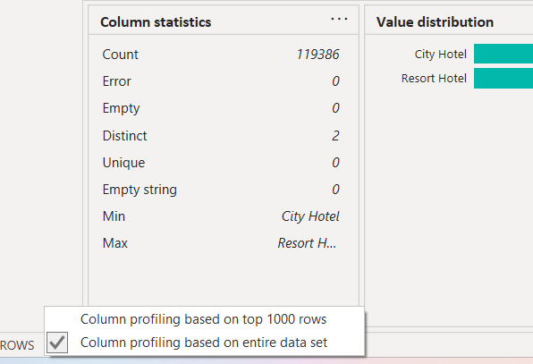
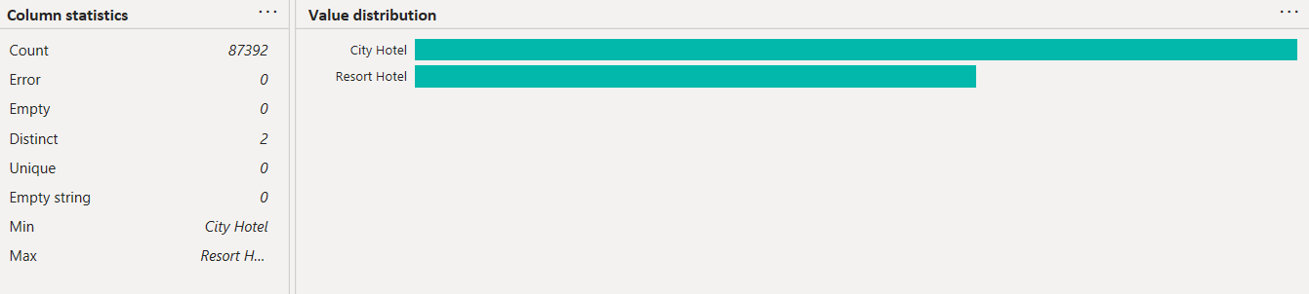
RESULT OF DATA CLEANING:
AFTER PERFORMING THE DATA CLEANING OPERATIONS
THE ROW COUNT REDUCE TO 87,392
BEFORE THE DATA CLEANING THE COUNT OF ROW WAS
1,19,386.

Slide 8

FEATURE ENGINEERING/DATA WRANGLING :
In this process we need to do some changes in data for example remove unnecessary column, merge two or more than two column, replace the value, add new column etc.
Stage 1 : remove date_week number.
Stage 2: merge the date, month and year column and the new column will be “date” into DD-MM-YYYY.
Stage 3 :change the data type of date from any to date formate.
Stage 4: Add the columns of “ Stay_in_weeknight” and “stay_in_weekenednight” using custom column function and the new colum will be “total_stay”.
Stage 5: change the data type of “total_stay” into “whole number”.
Stage 6: merge the columns of “children” “babies”, and “adults” using custom column function and the new column will “total_no_people”.

Slide 9
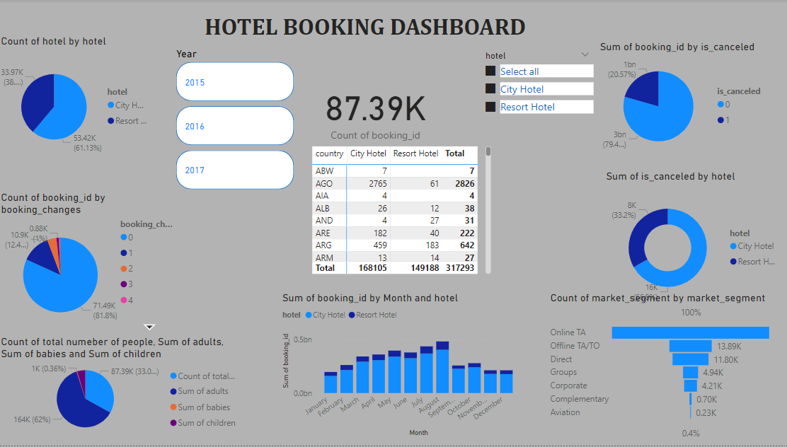

Slide 10
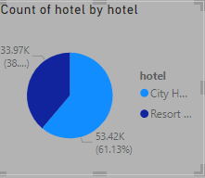
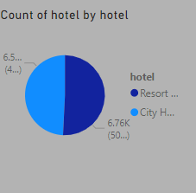
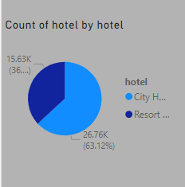
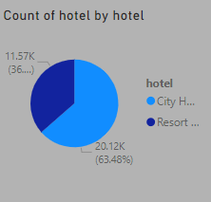
ANALYSING THE DASHBOARD
THE OVERALL RATION SHOWING THAT CITY HOTEL IS COMPERATIVELY HIGH AS COMPARED TO RESORT HOTEL
WHILE, IN 2015, BOTH THE RATIO WAS ALMOST HALF
IN 2016. THE BOOKING OF CITY HOTEL IS INCREASED BY 26.7% & RESORT HOTEL IS REDUCED BY 15.6%
NOT A BIG CHANGE AS COMPARED TO DATA OF 2016,
A MINOR INCREASE IN CITY HOTEL BY 20% AND REDUCTION IN RESORT BY 4%.

Slide 11
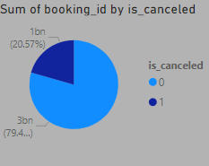
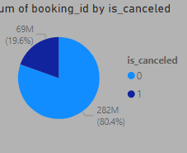
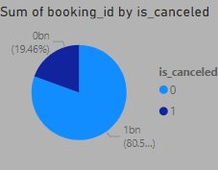
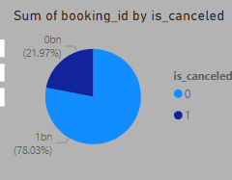
BOOKING CANCLE ANALYSIS:
IN 2015, CITY HOTEL CANCELLATION WAS 80.4%
WHERE AS RESORT WAS 19.6%.
IN 2017, THE CITY HOTEL CANCELLATION IS REDUCED TO 78%. WHILE RESORT HOTEL IS UPTO ALMOST 22%
OVERALL CANCELLATION IS
HIGH IN CITY HOTEL, WHILE IN RESORT HOTEL IS LESS.
SAME AS 2015, IN 2016 BUT IN CITY HOTEL IT INCREASE BY 0.1% AND REDUCE SIMENTANIOUSLY RESORT ONE.

Slide 12
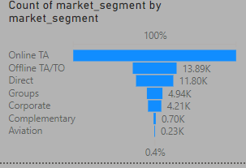
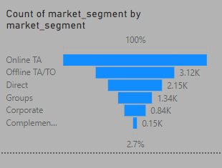
ANALYSIS OF MARKET SEGMENT :
OVERALL THE ONLINE/ OFFLINE TA/TO IS HIGH,
WHILE GROUP, DIRECT AND CORPORATE IS MODERATE,
AND COMPLEMENTARY AND AVIATION IS LOW.
IN 2015, THERE IS ONLINE AND OFFLINE TA IS COMPERATELY HIGH WAS 3.12K , WHILE, AVAITAION IS VERY LESS AROUND 2.7%

Slide 13
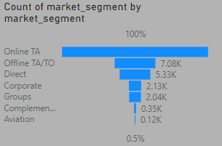
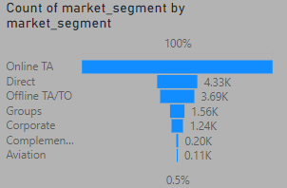
WHILE IN 2017, THERE ARE OFFLINE SEGMENT IS REDUCE TO 3.69K AND DIRECT SEGMENT IS INCREASED TO 4.33K
IN 2016, THERE WAS NO SEVERAL CHANGE AS COMPARED TO YEAR 2015

Slide 14
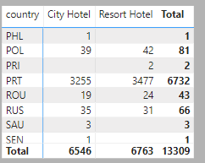
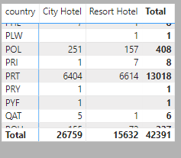
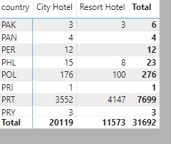
ANALYSIS ON THE BASIC OF COUNTRY:
IN 2015, HIGHEST CUSTOMER FROM PORTUGAL.
IN 2016, THE CUSTOMER FROM THE PORTUGAL WAS ALL TIME HIGER AS COMPARED TO YEAR 2015 AND 2017.
WHILE IN 2017, THE HIGHEST NUMBER OF CUSTOMER FROM THE SAME NATION AS BEFORE, BUT IT WAS BIT HIGH THAN 2015, BUT VERY LOW AS COMPARED TO YEAR 2016.

Slide 15
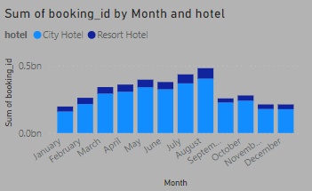
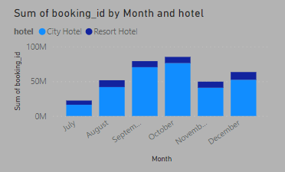
ANALYSIS ON THE BASIC OF MONTHLY BOOKING IN HOTEL :
OVERALL, THE AUGUST AND JULY IS HAVING NO. OF CUSTOMER IN BOTH CITY AND RESORT HOTEL.
IN THE YEAR 2015, THE BOOKING RATIO WAS ALMOST HIGH IN THE MONTH OF SEPTEMBER AND OCTOBER. ON THE OTHER HAND JULY MONTH WAS ALMOST LOWEST ONE.

Slide 16
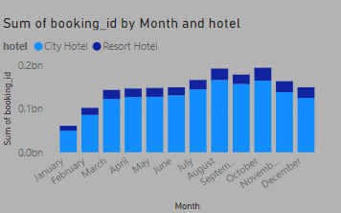
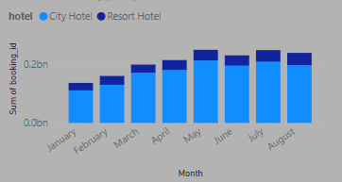
IN THE YEAR 2016, THE AUGUST AND OCTOBER WAS COMPERATELY HIGH WHILE JANUARY WAS LOW.
WHERE AS IN THE YEAR 2017, THE MONTH OF MAY AND JULY WAS HIGH WHILE, JANUARY WAS LOW SIMILAR LIKE 2016.

Slide 17
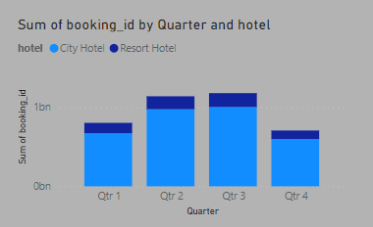
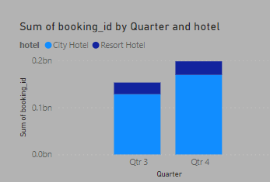
ANALYSIS ON THE BASIC OF QUARTERLY BOOKING
THE OVERALL BOOKING BY QUARTERLY SHOWING THAT 2ND AND 3RD QUARTER ARE HAVING MORE NO. OF BOOKING.
AS COMPERED TO OVERALL HIGHEST BOOKING IS IN 3RD AND 4TH QUARTER WHILE 1ST AND 2ND IS 0. IN 2015

Slide 18
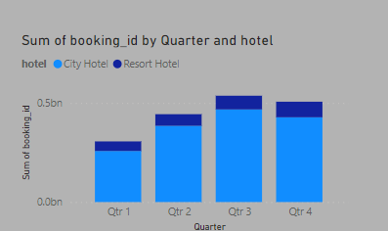
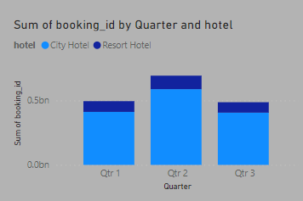
IN THE YEAR 2016, THE 3RD AND 4TH QUARTER IS COMPERATIVELY HIGH NUMBER OF BOOKING WHILE IN QUARTER 1 WE HAVE LOW.
IN THE YEAR 2017, THE 2ND QUARTER IS HAVING HIGH NUMVER OF BOOKING AND 1ST AND 3RD IS QUITE SIMILAR.

Slide 19
MY SUGGESTION ON THE BASIC OF ANALYSIS.
Both the city and resort hotel need to improvement.
If there is possibility that resort hotel is somehow far from the city or from stations.
If yes then provide a transport facility (pickup and drop off) if they are booking the resort hotel
The cancellation rate is very high in both the hotels in all the three year, to reduce it make the booking charge and that must non-refundable.
In the market segment, maintain the online and offline booking but try to improvement in booking process and overall management especially for the corporate sectors customers, also introduce some offer like 10% off, meal complementry etc.
According to the analysis on the basic of countries, customers from Portugal is all time high, to maintain it provide some more better services and offer them some complement.
7. According to monthly analysis the month of august, September and October is/was having high number of booking so to maintain and provide more better temperory increase staff, for these 3 months.

Slide 20
Thank you, have a nice day

